Slide 1
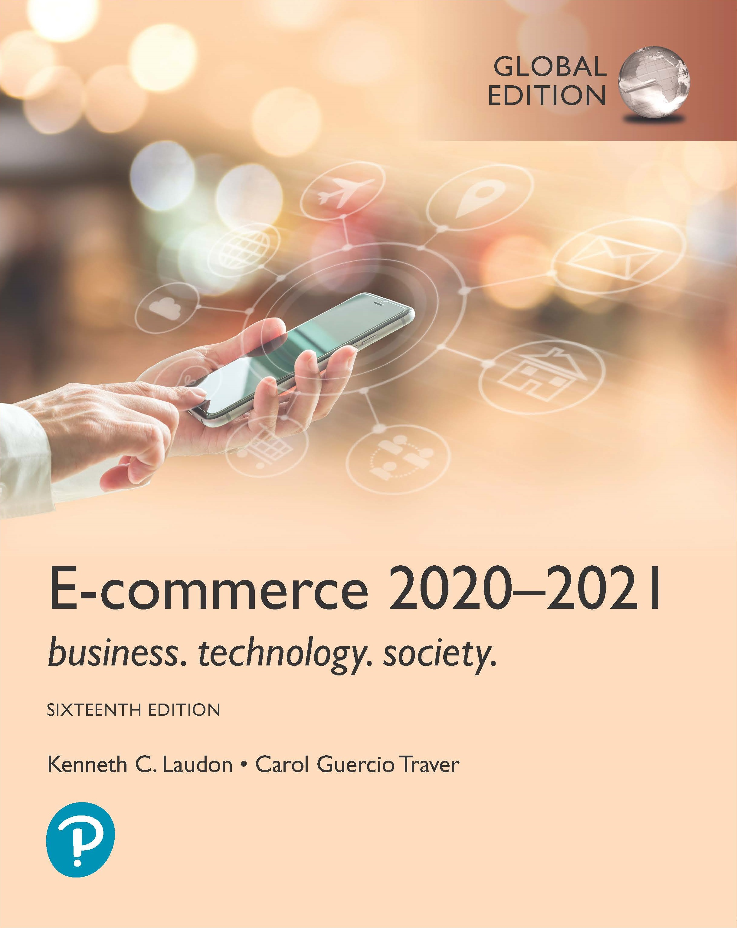
E-commerce 2020-2021: Business. Technology. Society.
Sixteenth Edition, Global Edition
Chapter 4
E-commerce Security and Payment Systems
Copyright © 2021 Pearson Education Ltd. All Rights Reserved
Notes:
If this PowerPoint presentation contains mathematical equations, you may need to check that your computer has the following installed:
1) MathType Plugin
2) Math Player (free versions available)
3) NVDA Reader (free versions available)

Slide 2
Learning Objectives
4.1 Understand the scope of e-commerce crime and security problems, the key dimensions of e-commerce security, and the tension between security and other values.
4.2 Identify the key security threats in the e-commerce environment.
4.3 Describe how technology helps secure Internet communications channels and protect networks, servers, and clients.
4.4 Appreciate the importance of policies, procedures, and laws in creating security.
4.5 Identify the major e-commerce payment systems in use today.
4.6 Describe the features and functionality of electronic billing presentment and payment systems.

Slide 3
The Rise of the Global Cyberattack
Class Discussion
Have you or anyone you know been the subject of a cybercrime? If so, what happened?
Do you think an agreement among countries akin to the Geneva Convention will be an effective deterrent for cybercrime? Why or why not?
What steps have you taken to protect yourself online?

Slide 4
The E-commerce Security Environment
Scope of the problem
Overall size of and losses due to cybercrime unclear
McAfee/Center for Strategic and International Studies study: Global economic impact of cybercrime and cyberespionage between $455 billion to $600 billion
Reports by security product providers indicate increasing cybercrime
Online credit card fraud one of the most high-profile forms
Bot networks, DDoS attacks, Trojans, phishing, ransomware, data theft, identity fraud, credit card fraud, spyware are just some of the threats
Underground economy marketplaces sell stolen information, malware and more

Slide 5
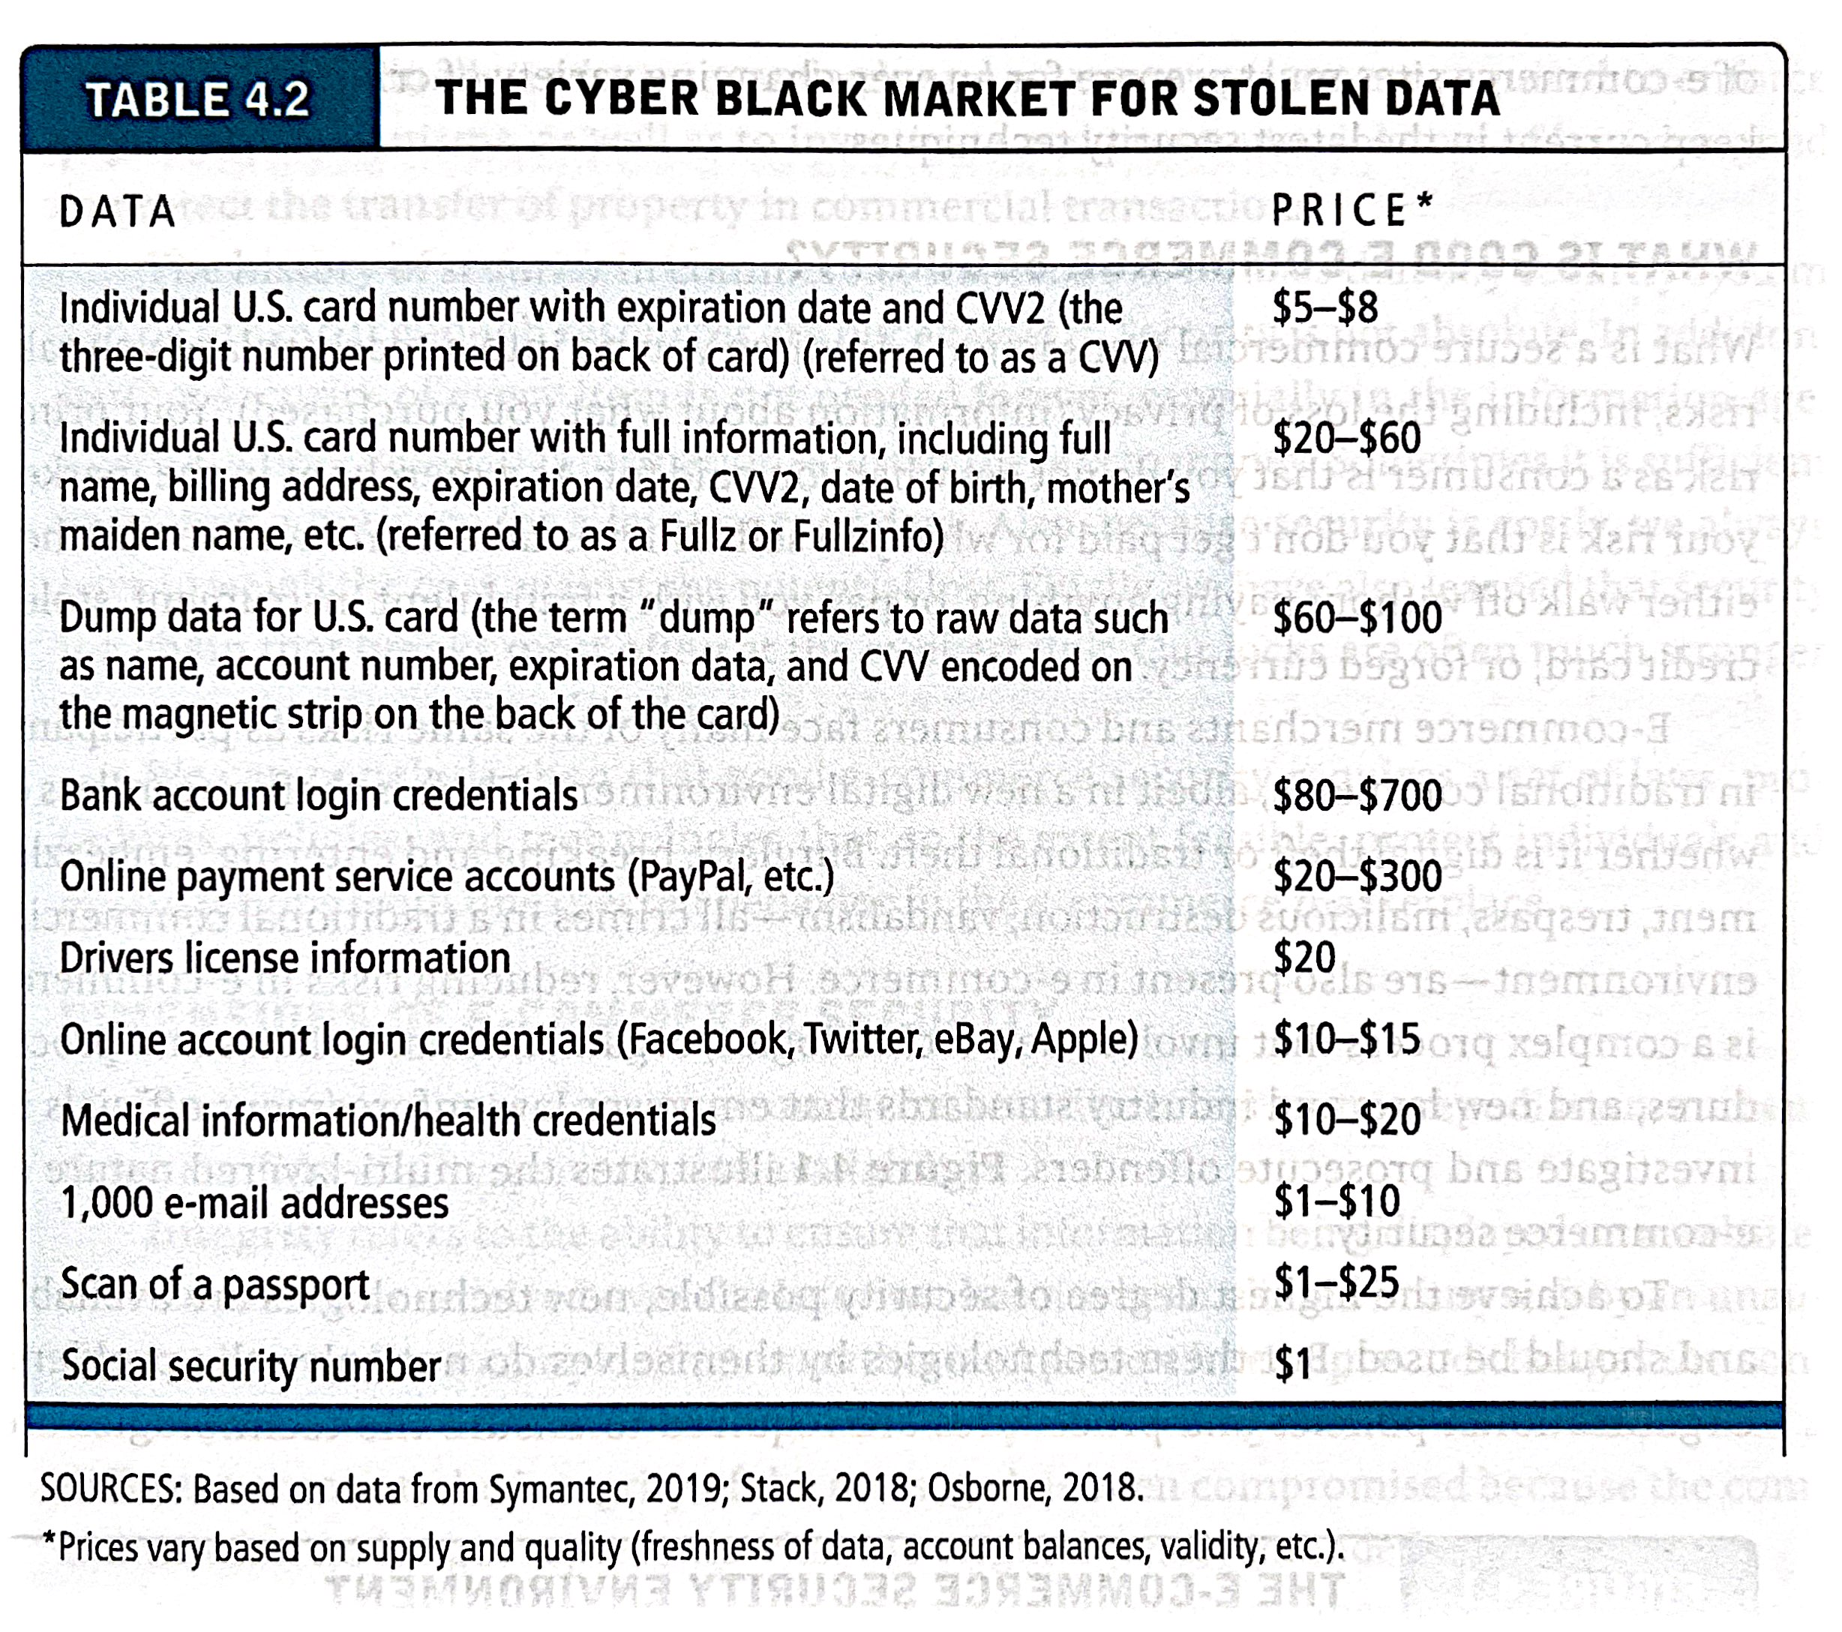

Slide 6
What is Good E-commerce Security?
To achieve highest degree of security
New technologies must be used
Organizational policies and procedures are required to ensure the technologies are not subverted.
Industry standards and government laws are required to enforce payment mechanisms, as well as to investigate and prosecute violators of laws.
Other factors
Time value of information as there is to money
Cost of security versus potential loss
Security often breaks at weakest link

Slide 7
Figure 4.1 The E-commerce Security Environment
Notes:
Figure 4.1, Page 260.
E-commerce security is multi-layered, and must take into account new technology, policies and procedures, and laws and industry standards.
Full description: A bulls-eye diagram depicts the multi-layered nature of the e-commerce security environment. The diagram has Data in center. There are four concentric ovals. From the inner-most oval to the outer-most one, the ovals are labeled as follows, Technology Solutions, Organizational Policies and Procedures, and Laws and Industry Standards.

Slide 8
Table 4.3 Customer and Merchant Perspectives on the Different Dimensions of E-commerce Security
Dimension | Customer’s Perspective | Merchant’s Perspective
Integrity | Has information I transmitted or received been altered? | Has data on the site been altered without authorization? Is data being received from customers valid?
Nonrepudiation | Can a party to an action with me later deny taking the action? | Can a customer deny ordering products?
Authenticity | Who am I dealing with? How can I be assured that the person or entity is who they claim to be? | What is the real identity of the customer?
Confidentiality | Can someone other than the intended recipient read my messages? | Are messages or confidential data accessible to anyone other than those authorized to view them?
Privacy | Can I control the use of information about myself transmitted to an e-commerce merchant? | What use, if any, can be made of personal data collected as part of an e-commerce transaction? Is the personal information of customers being used in an unauthorized manner?
Availability | Can I get access to the site? | Is the site operational?
Notes:
integrity the ability to ensure that information being displayed on a website or transmitted or received over the Internet has not been altered in anyway by an unauthorised party.
nonrepudiation the ability to ensure that he comes participants do not deny their online actions
authenticity the ability to identify the identity of a person or entity with whom you are dealing on the Internet
confidentiality the ability to ensure that messages and data are available only to those who are authorised to view them
privacy the ability to control the use of information about oneself
availability the ability to ensure that an e-commerce site continues to function as intended

Slide 9
The Tension between Security and Other Values
Ease of use
The more security measures added, the more difficult a site is to use, and the slower it becomes
Public safety and criminal uses of the Internet
Use of technology by criminals to plan crimes or threaten nation-state

Slide 10
Security Threats in the E-commerce Environment
Three key points of vulnerability in e-commerce environment:
Client
Server
Communications pipeline (Internet communications channels)

Slide 11
Figure 4.2 A Typical E-commerce Transaction
Notes:
Figure 4.2, Page 264.
In a typical e-commerce transaction, the customer uses a credit card and the existing credit payment system.
Full description: A flow diagram depicts a typical e-commerce transaction. The steps involved in the transaction are as follows. An Online consumer contacts an Online store through an Internet service provider. The online store uses a Merchant website and Merchant web server which connects with a Database server which connects with a Warehouse. The Customer credit card bank transacts with the Merchant bank through the Merchant website and Merchant Web servers. All of the above transactions and connections are two-way. Last, the Warehouse uses a Shipping service to ship the product to the Online consumer.

Slide 12
Figure 4.3 Vulnerable Points in an E-commerce Transaction
Notes:
Web Beacon
Also known as a web bug, pixel tag or clear GIF, a web beacon is a clear graphic image (typically one pixel in size) that is delivered through a web browser or HTML e-mail.
Figure 4.3, Page 265.
There are three major vulnerable points in e-commerce transactions: Internet communications, servers, and clients.
Full description: A flow diagram depicts the vulnerable points in an e-commerce transaction. The steps involved in the transaction are as follows. An Online consumer contacts an Online store through an Internet service provider. The online store uses a Merchant website and Merchant web server which connects with a Database server which connects with a Warehouse. The Customer credit card bank transacts with the Merchant bank through the Merchant website and Merchant Web servers. All of the above transactions and connections are two-way. Last, the Warehouse uses a Shipping service to ship the product to the Online consumer.
Vulnerable points in the process include web beacons in the Online consumer’s system, Wi-Fi listening wiretaps in the connection between the consumer and Internet service provider, Customer list hacks in the online store’s system, S Q L injection attacks on the database server, D O S attacks, card theft, or hacking at the customer credit card bank’s end, and security breaches at the point where the Customer credit card bank, Merchant bank, and the Merchant web servers and Merchant website connect, and when the order is shipped to the Online consumer.

Slide 13
Malicious Code (or Malware)
Exploits – software vulnerability in OS
Exploit kits – collection of exploits bundled together and rented or sold as a commercial product
Malvertising – Online advertising that contains malicious code
Drive-by downloads – malware that comes with a download file that a user requests
Viruses – spreads from file to file via a host
Worms – spreads from computer to computer without any human activation
Ransomware – prevents from accessing computer or files and demand that you pay a fine
Trojan horses – appears to be benign but does something other than expected.
Backdoors – feature of viruses, worms and Trojans that allow an attacker to remotely access a compromised computer
Bots – type of malicious code that can be covertly installed on a computer when connected to the Internet. Then the bot responds to extyernal commands sent by the attacker,
Botnets – collection/network of captured bot computers.
Notes:
According to Symantec, about 246 million new variants of malware were created in 2018.
Exploits are often the first part of a larger attack. Hackers scan for outdated systems that contain critical vulnerabilities, which they then exploit by deploying targeted malware. Exploits often include shellcode, which is a small malware payload used to download additional malware from attacker-controlled networks. Shellcode allows hackers to infect devices and infiltrate organizations.
An exploit kit is a tool used for automatically managing and deploying exploits against a target computer. Exploit kits allow attackers to deliver malware without having advanced knowledge of the exploits being used.
Malvertising: The practice of incorporating malware in online advertisements.
A drive-by download attack refers to the unintentional download of malicious code to your computer or mobile device that leaves you open to a cyberattack.
Viruses and worms both cause damage and copy themselves rapidly. The main difference is how they self-replicate, with viruses requiring the help of a host and worms acting independently. Unlike viruses, worms can replicate and spread without any human activation.
Viruses are executed via executable files.
Worms are executed via weaknesses in system.
Trojan horse executes through a program and interprets as utility software.
A backdoor is a typically covert method of bypassing normal authentication or encryption in a computer, product, embedded device (e.g. a home router), or its embodiment.
Botnets are a network of infected computers, or bots, under the control of a single party, known as a “botnet master”. Hackers infect computers with malware that allows them to remotely operate infected devices as bots.

Slide 14
Potentially Unwanted Programs(PUPs)
In addition to malicious code, the e-commerce security environment is further challenged by PUPs, also known as PU Applications, such as:
Browser parasites
Monitor and change user’s browser settings
Adware
Used to call pop-up ads
Spyware
Tracks users keystrokes, e-mails, I M s, etc.
Notes:
Unsolicited software that is installed in a computer without users realizing it.
Example of PUP is: PCProtect which infects PCs running Windows Oss. Poses as a legitimate anti-malware program when in fact it is malware.

Slide 15
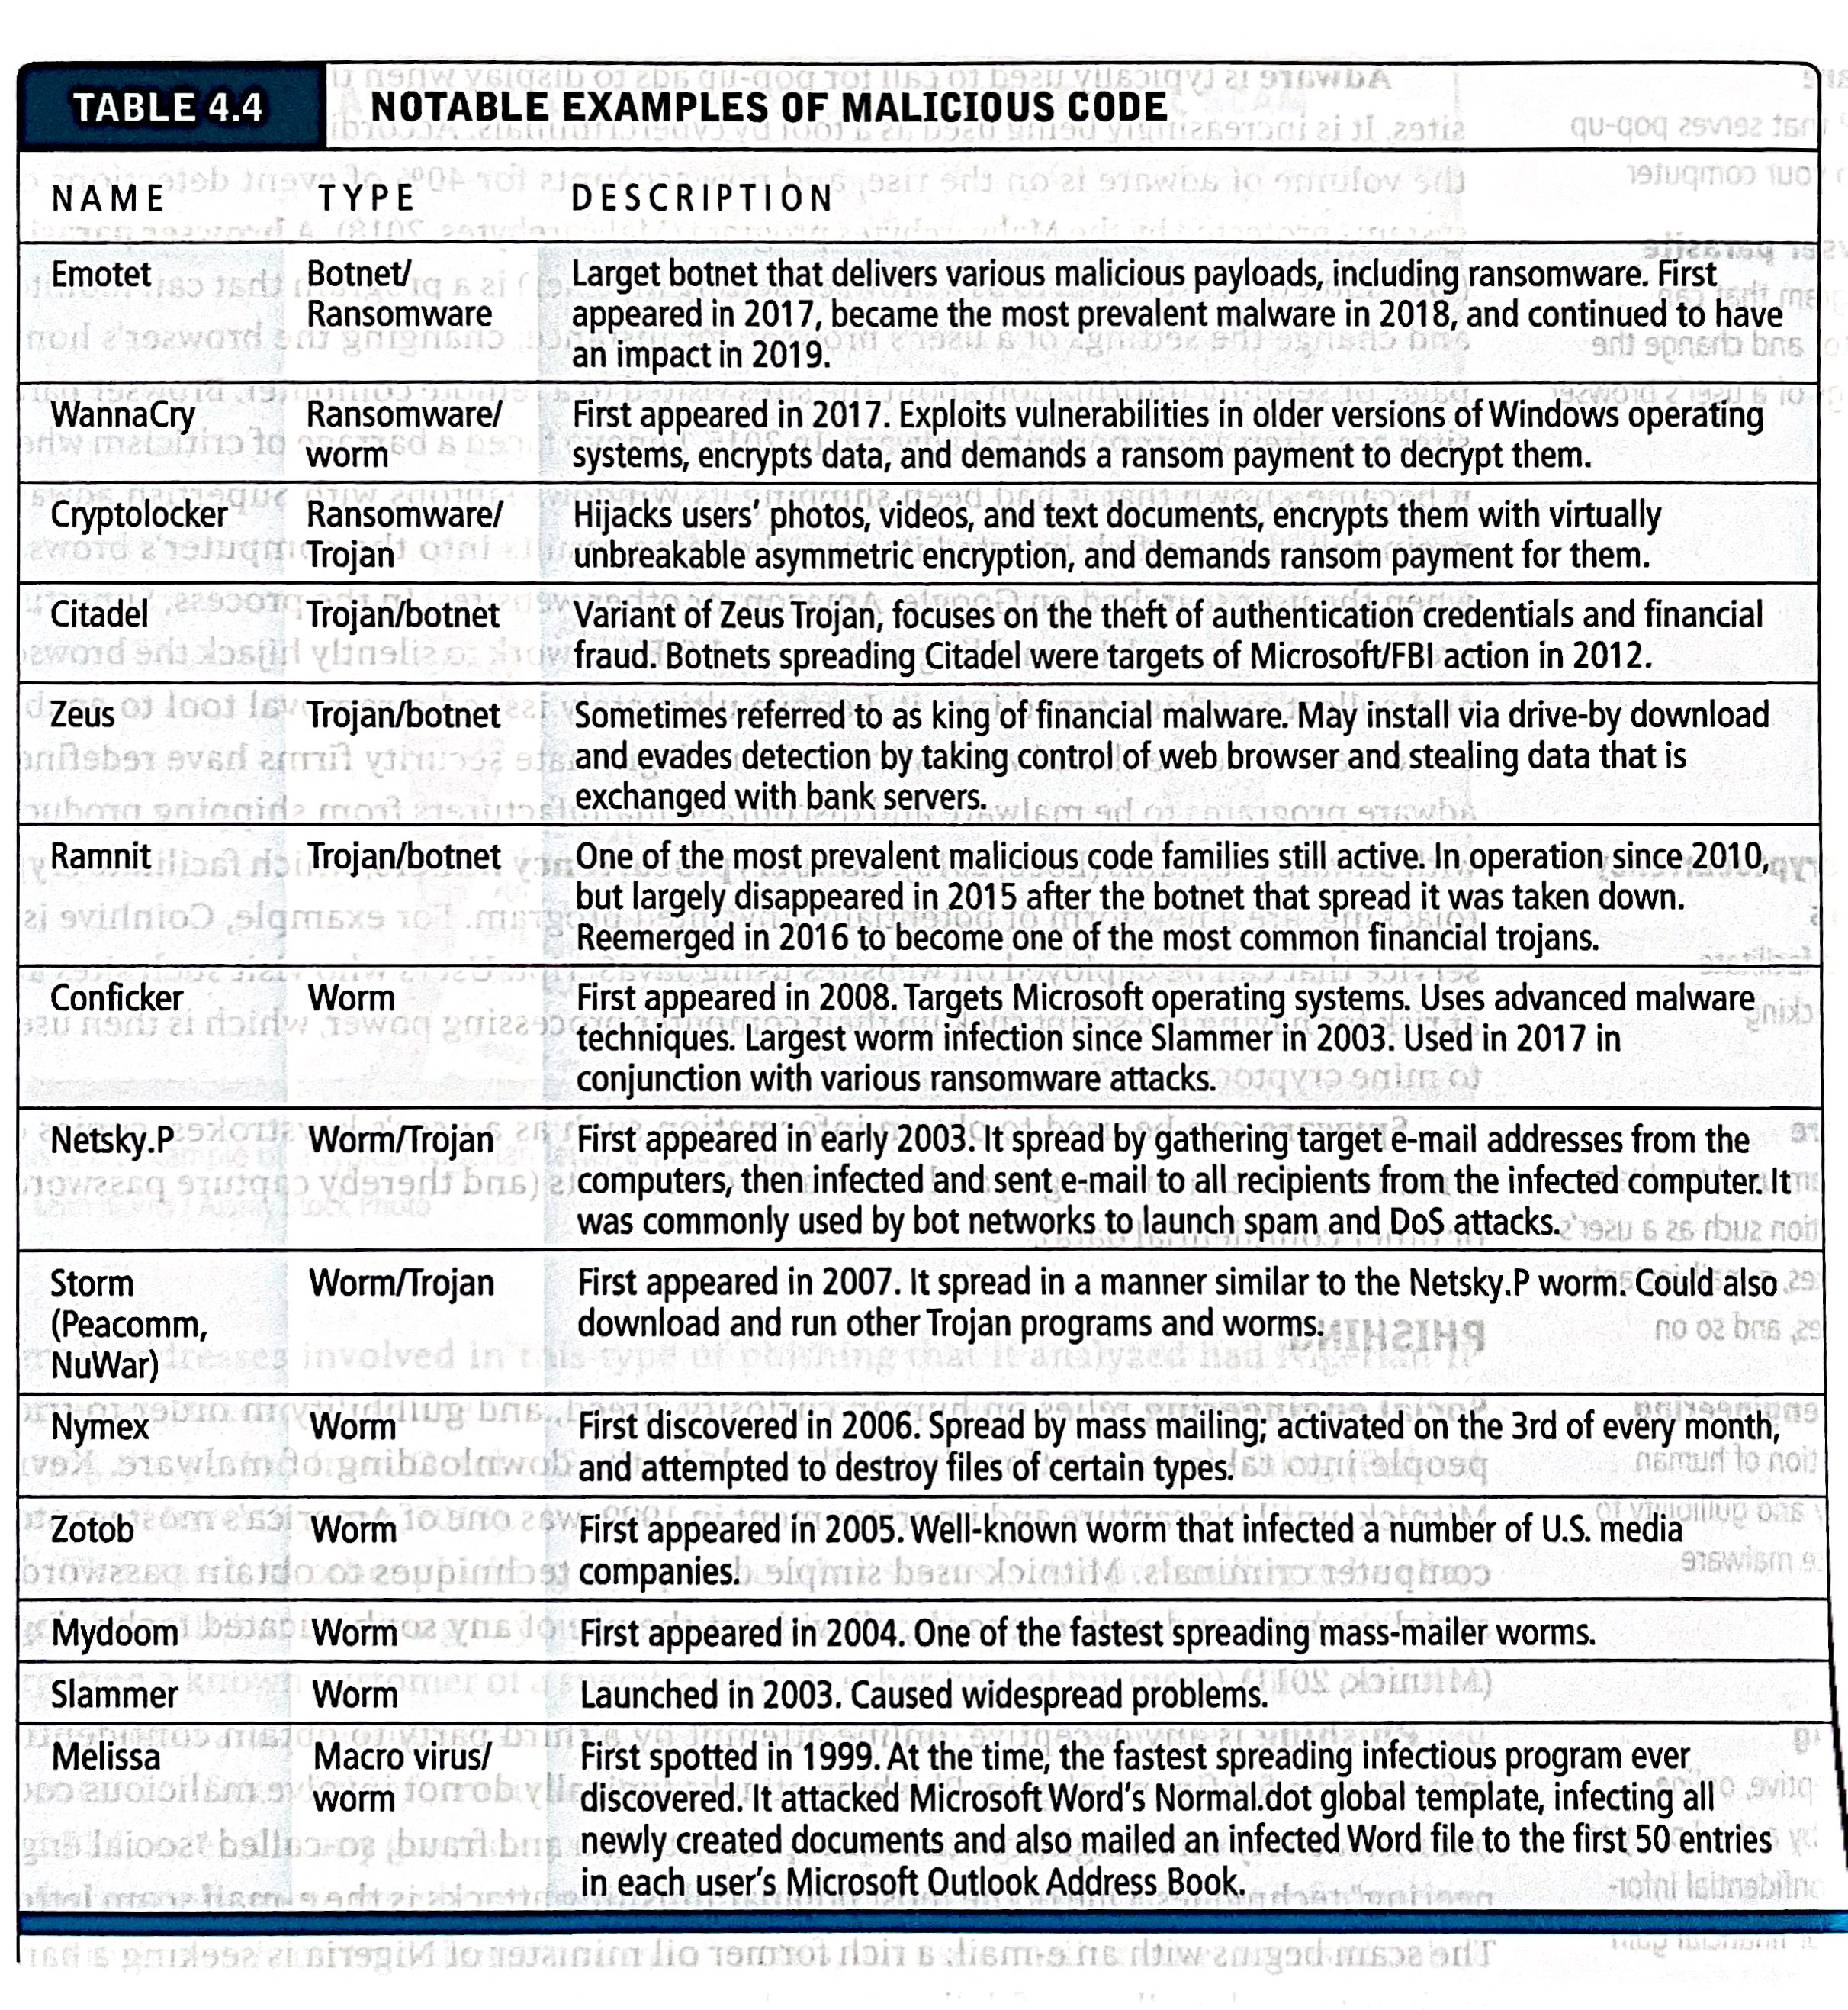

Slide 16
Phishing
Any deceptive, online attempt by a third party to obtain confidential information for financial gain
Tactics
Social engineering
E-mail scams and BEC phishing – variation of Nigerian letter scams in which an attacker poses as a high-level employee of a company and requests that another employee transfer funds to a fraudulent account
Spear phishing – pretending to be eBay, PayPal or Citi Bank writing to you for account verification
Used for identity fraud and theft
Notes:
Business email compromise (BEC) is a specific type of phishing attack, a spear phishing attack to be precise – with the objective being to trick employees into taking harmful actions, typically sending money to the attacker.
“Spear phishing” is a type of phishing campaign that targets a specific person or group and often will include information known to be of interest to the target, such as current events or financial documents.

Slide 17
Hacking, Cybervandalism, and Hacktivism
Hacking
Hacker – an individual who indents to gain unauthorised access to a computer system.
Cracker – hacker with criminal intent
White hats – to fix flaws
Black hats – causing harm
Grey hats – revealing system flaws
Tiger teams - skilled hackers who will seek to penetrate a network or other tech environment for the purposes of improving security and closing security loopholes.
Goals: cybervandalism, data breaches
Cybervandalism:
Disrupting, defacing, destroying Web site
Hacktivism
Cybervandelism and data theft for political purposes.
Notes:
The Hackers being the good guys, are called white hats, while black hats usually refer to the crackers which violate computer security for personal gains.
Derived from combining the words 'Hack' and 'Activism', hacktivism is the act of hacking, or breaking into a computer system, for politically or socially motivated purposes. The individual who performs an act of hacktivism is said to be a hacktivist.
An example of hacktivism is a denial of service attack (DoS) which shuts down a system to prevent customer access.
In civilian use, particularly in IT, a tiger team is usually composed of skilled hackers who will seek to penetrate a network or other tech environment for the purposes of improving security and closing security loopholes.
The WANK worm had a distinct political message attached, and it was the first major worm to have a political message.^{[1]} WANK in this context stands for Worms Against Nuclear Killers. The following message appeared on infected computer's screen:

Slide 18
Data Breaches
Organization loses control over corporate information to outsiders
The ITRC (Identity Theft Resource Centre) recorded 1,244 breaches in 2018, a decrease in 23% over 2017
Yahoo and Equifax two of the most notorious; Facebook breach in 2018 exposed personal information of 30 million.
(https://www.dataleaklawyers.co.uk/blog/yahoo-equifax-ceo-testify-largest-data-breaches-history)
Leading causes
Hacking
Unauthorized access
Employee error/negligence

Slide 19
Insight on Society: The Marriott Data Breach
Class Discussion
What organizational and technological failures led to the data breach at Marriott?
What technical solutions are available to combat data breaches?
Have you or anyone you know experienced a data breach?
https://www.bbc.co.uk/news/technology-54748843
(Mariott Data breach)

Slide 20
Credit Card Fraud/Theft
Stolen credit card incidences about 0.9% on the Web and about 0.8% of mobile transactions
Hacking and looting of corporate servers is primary cause
Central security issue: establishing customer identity
E-signatures
Multi-factor authentication
Fingerprint identification

Slide 21
Identity Fraud/Theft
Unauthorized use of another person’s personal data for illegal financial benefit
Social security number
Driver’s license
Credit card numbers
Usernames/passwords
2017: Almost 17 million U.S. consumers suffered identity fraud
2018: 14.4 million US consumers suffered identity fraud.

Slide 22
Spoofing, Pharming, and Spam (Junk) Websites
Spoofing
Attempting to hide an identity by using someone else’s e-mail or IP address
Pharming
Automatically redirecting a U R L to a different address, to benefit the hacker
Spam (junk) websites
Promise to offer products or services, but in fact are just collection of advertisements for other sites, which may contain malicious code

Slide 23
Sniffing and Man-In-The-Middle Attacks
Sniffer
Eavesdropping program monitoring networks
Can identify network trouble spots when used legitimately
Can be used by criminals to steal proprietary information
E-mail wiretaps
Variation on the sniffing threat, a method of recording e-mails at the mail server level
Man-in-the-middle attack
Attacker intercepts and changes communication between two parties who believe they are communicating directly but is more active than a sniffing attack, which is involves passive monitoring.
Notes:
For instance, in 2013 five hackers were charged in another worldwide hacking scheme that targeted the corporate networks of retail chains such as 7-Eleven and the French retailer Carrefour SA, using sniffer programmes to steal more than 160 million credit card numbers

Slide 24
Denial of Service (DoS) and Distributed Denial of Service (DDoS) Attacks
Denial of service (DoS) attack
Flooding website with pings and page request
Overwhelm and can shut down site’s web servers
Often accompanied by blackmail attempts
Botnets
Distributed Denial of Service (DDoS) attack
Uses hundreds or thousands of computers to attack target network
Can use devices from Internet of Things, mobile devices
DDoS smokescreening
Notes:
The largest DDoS attack in the Internet history was launched against GitHub the open source software development platform in February 2018.
in 2016 the Mirai botnet launched a large-scale DDoS attack using Internet devices such as refrigerators, security cameras etc against an Internet domain resolving firm, Dyn. Twitter, Amazon, Netflix, Airbnb, The New York Times and many other sites across the country were affected. Hackers were able to guess the administrator passwords of common devices
DDoS could be used as a smokescreen, to pivot the defending team’s attention away from a more sophisticated and precise simultaneous offence, such as ATO (Account Takeover) or phishing.

Slide 25
Insider Attacks
Largest threat to business institutions come from insider embezzlement
Employee access to privileged information
Poor security procedures
Insiders more likely to be source of cyberattacks than outsiders
Notes:
Embezzlement: Theft or misappropriation of funds placed in one's trust or belonging to one's employer.

Slide 26
Poorly Designed Software
Increase in complexity of and demand for software has led to increase in flaws and vulnerabilities
S Q L injection attacks
Zero-day vulnerability
Heartbleed bug
takes advantage of poorly coded wep app that fails to properly validate or filter data entered by s user.
Software vulnerability that has been previously unreported and for which no patch yet exits
Flaw in OpenSSL encryption system that allowed hackers to decrypt an SSL session and discover usernames, passwords, and other user data
Notes:
A zero-day vulnerability is a vulnerability in a system or device that has been disclosed but is not yet patched.
The Heartbleed bug is a vulnerability in open source software that was first discovered in 2014. Anyone with an internet connection can exploit this bug to read the memory of vulnerable systems, leaving no evidence of a compromised system.
Shellshock is a vulnerability that allows systems containing a vulnerable version of Bash to be exploited to execute commands with higher privileges.
The FREAK vulnerability refers to a weakness in the Secure Sockets Layer (SSL)/Transport Layer Security (TLS) protocols caused by the use of ‘export-grade’ encryption. The name stands for ‘Factoring RSA Export Keys’.

Slide 27
Social Network Security Issues
Social networks an environment for:
Viruses, site takeovers, identity fraud, malware-loaded apps, click hijacking, phishing, spam
Manual sharing scams
Victims unwittingly share videos, stories, and pictures that include links to malicious sites
Other techniques include fake offerings, fake Like buttons, and fake apps

Slide 28
Mobile Platform Security Issues
Little public awareness of mobile device vulnerabilities
2017: Over 26,500 different mobile malware variants identified by Symantec
Vishing attacks a gullible cell phone users with verbal messages to call a certain number and donate money for starving children
Smishing attacks exploit SMS/text messages, which can contain e-mail and website addresses that can lead innocent user to malware site
SMS spoofing – luring user to a malicious website by sending a text from a legitimate organisation.
Madware - innocent-looking apps that contain adware that launches pop-up ads
Notes:
Vishing is a cyber crime that uses the phone to steal personal confidential information from victims. Often referred to as voice phishing, cyber criminals use savvy social engineering tactics to convince victims to act, giving up private information and access to bank accounts.
Most people have heard of phishing; vishing is a different attack that falls under the general phishing umbrella and shares the same goals. Vishers use fraudulent phone numbers, voice-altering software, text messages, and social engineering to trick users into divulging sensitive information.
Smishing is a form of phishing that uses mobile phones as the attack platform. The criminal executes the attack with an intent to gather personal information, including social insurance and/or credit card numbers. Smishing is implemented through text messages or SMS, giving the attack the name “SMiShing.”
SMS spoofing is a technique that allows us to change the sender information on a text sent via the short message service (SMS) system. SMS text messages are used by cell phones, personal digital assistants, and similar devices and are typically just known as text messages.
When you send a spoof text, they replace the originating mobile number (sender ID) with alphanumeric text. In simpler words, SMS spoofing allows you to change the sender’s display number. As it allows you to change the originator details, it’s also regarded as “SMS originator spoofing.”
Madware is a type of aggressive advertising that affects smartphones and tablets

Slide 29
Insight on Technology: Think Your Smartphone Is Secure?
Class Discussion
What types of threats do smartphones face?
Are there any vulnerabilities specific to mobile devices?
What qualities of apps make them a vulnerable security point in smartphone use?
Are apps more or less likely to be subject to threats than traditional P C software programs?

Slide 30
Cloud Security Issues
D D o S attacks
Infrastructure scanning, which assess the security level of the infrastructure.
Lower-tech phishing attacks yield passwords and access
Use of cloud storage to connect linked accounts
Lack of encryption and strong security procedures
Most organisations are not taking the responsibility for the security of their data in the cloud, instead looking to their cloud providers to provide that security

Slide 31
Internet of Things Security Issues
Challenging environment to protect
Vast quantity of interconnected links
Near identical devices with long service lives
Many devices have no upgrade features
Little visibility into workings, data, or security
Notes:
In 2015,researchers demonstrated the ability to hack into a Jeep Cherokee through its entertainment system sending commands to the dashboard, steering, brakes, and transmission system from a remote laptop that turned the steering wheel, disabled the brakes, shutting down the engine. Fiat Chrysler automobiles immediately issued a recall notice to fix this software vulnerability involved but it's almost certain that such incidents will continue to occur as auto manufacturers add more and more wireless connected car features to automobiles

Slide 32
Technology Solutions
Protecting
Protecting Internet communications
Encryption
Securing
Securing channels of communication
S S L, T L S, V P N s, Wi-Fi
Protecting
Protecting networks
Firewalls, proxy servers, I D S, I P S
Protecting
Protecting servers and clients
O S security, anti-virus software
Notes:
Intrusion Prevention System.
Intrusion Detection System.
Transport Layer Security

Slide 33
Figure 4.5 Tools Available to Achieve E-commerce Security
Notes:
Figure 4.5, Page 288.
There are a number of tools available to achieve e-commerce security.
Full description: A diagram depicts the different tools available to achieve e-commerce security. The diagram shows Security Management in the center and the following points surrounding it. Firewalls, Encryption, Network Security Protocols, Virtual Private Networks, Authentication Procedures, Proxy Servers, Anti-Virus Software, Automated Software Updates, Intrusion Detection and Prevention.

Slide 34
Encryption
Encryption
Transforms data into cipher text readable only by sender and receiver
Secures stored information and information transmission
Provides 4 of 6 key dimensions of e-commerce security:
Message integrity – provides assurance that the message has not been altered
Nonrepudiation – prevents the use from denying he or she sent the message
Authentication – provides verification of the identity of the person sending the message.
Confidentiality – gives assurance that the message was not read by others
Notes:
Two of the 6 key dimensions of the e-commerce security
Privacy
Availability

Slide 35
Symmetric Key Cryptography
Sender and receiver use same digital key to encrypt and decrypt message
Requires different set of keys for each transaction
Strength of encryption: Length of binary key
Data Encryption Standard (DES) - The data encryption standard developed by the National Security Agency (NSA) and IBM 1950s DES uses a 56-bit encryption key.
Advanced Encryption Standard (AES) - Today the most widely used symmetric key algorithm is advanced encryption standard which offers key sizes of 128, 192 and 256 bits
Other standards use keys with up to 2,048 bits

Slide 36
Public (Asymmetric) Key Cryptography
Uses two mathematically related digital keys
Public key (widely disseminated)
Private key (kept secret by owner)
Both keys used to encrypt and decrypt message
Once key used to encrypt message, same key cannot be used to decrypt message
Sender uses recipient’s public key to encrypt message; recipient uses private key to decrypt it

Slide 37
Figure 4.6 Public Key Cryptography: A Simple Case
Notes:
Figure 4.6, Page 291.
In the simplest use of public key cryptography, the sender encrypts a message using the recipient’s public key, and then sends it over the Internet. The only person who can decrypt this message is the recipient, using his or her private key. However, this simple case does not ensure integrity or an authentic message.
Full description: An image illustrates a simple use of public key cryptography and the important steps in using public and private keys. The steps are as follows. First, the sender creates an original digital message, to buy X Y Z at the rate of 100 dollars. Second, the sender obtains the recipient’s public key and applies it to the message. Third, this message gets encrypted in cipher text, depicted as 1 0 1 0 1 1 0 1 1 1 0 0 0 1. Fourth, the message is sent over the Internet. And fifth, the message is received by the recipient, who uses his or her private key to decrypt the message..

Slide 38
Securing Channels of Communication
Secure Sockets Layer (S S L)/Transport Layer Security (T L S)
Establishes secure, negotiated client-server session
Virtual Private Network (V P N)
Allows remote users to securely access internal network via the Internet
Wireless (Wi-Fi) networks
WPA2
WPA3
Wi-Fi Protected Access
Is the most common form of securing channels

Slide 39
Protecting Networks
Firewall
Hardware or software that uses security policy to filter packets
Packet filters – examine data packets to determine whether they are destined for a prohibited port or originate from a prohibited IP address
Application gateways – that filters communications based on the application being requested.
Next-generation firewalls – uses an application-centric approach
Proxy servers (proxies)
Software servers that handle all communications from or sent to the Internet acting as a bodyguard for the organisation.
Intrusion detection systems
Intrusion prevention systems
Notes:
IDS – examines network traffic, watching to see if it matches certain patterns or preconfigured rules indicative of an attack.
IPS – has all functionality of an IDS, with the additional ability to take steps to prevent and block suspicious activities

Slide 40
Figure 4.11 Firewalls and Proxy Servers
Notes:
Figure 4.11, Page 301.
The primary function of a firewall is to deny access by remote client computers to local computers. The primary purpose of a proxy server is to provide controlled access from local computers to remote computers.
Full description: A set of flow diagrams illustrates how firewalls and proxy servers provide protection for networks. A linear flow diagram for a firewall shows, from left to right, a laptop, desktop, and a mobile phone connected to a firewall with two-way arrows. The firewall connects with a remote client on the Internet through a web server. A remote server is present on the side of the remote client. A linear flow diagram for proxy server shows, from left to right, a laptop, desktop, and a mobile phone connected two-way with an internal network. The internal network is connected two-way with a proxy server. The proxy server connects to a remote client on the Internet through an external network. A remote server is present on the side of the remote client.

Slide 41
Protecting Servers and Clients
Operating system security enhancements
Upgrades, patches
Anti-virus software
Easiest and least expensive way to prevent threats to system integrity
Requires daily updates

Slide 42
Management Policies, Business Procedures, and Public Laws
Worldwide, companies spend more than $86 billion on security hardware, software, services
Managing risk includes:
Technology
Public laws and active enforcement
Effective management policies

Slide 43
Developing an E-commerce Security Plan:
Five steps involved in building an e-commerce security plan
Notes:
Perform a risk assessment: An assessment of the risks and points of vulnerability
Develop a security policy: A set of statements prioritizing the information risks, identifying acceptable risk targets, and identifying the mechanisms for achieving these targets.
Develop an implementation plan: The action steps you will take to achieve the security plan goals
Create a security organization educates and trains users, keeps management aware of security threats and breakdowns, and maintains the tools chosen to implement security
Perform a security audit: involves the routine review of access logs (identifying how outsiders are using the site as well as how insiders are accessing the site’s assets)

Slide 44
The Role of Laws and Public Policy
Laws that give authorities tools for identifying, tracing, prosecuting cybercriminals:
U S A Patriot Act, which expanded law enforcement’s investigative and surveillance powers.
Homeland Security Act, preventing and responding to natural and man-made disasters.
Private and private-public cooperation
U S-C E R T (Computer Emergency Readiness Team)
C E R T Coordination Center – Monitors and tracks online criminal activity
Government policies and controls on encryption software
O E C D(Organisation for Economic Cooperation and Development), G7/G8, Council of Europe, Wassener Arrangement
Notes:
Wassener Arrangement – which includes 42 countries that produce sensitive industrial equipment or weapons

Slide 45
E-commerce Payment Systems
In U.S., credit and debit cards are primary online payment methods
Other countries have different systems
Limitations of online credit card payment
Security, merchant risk
Administrative and transaction costs
Social equity – not very democratic, even though they seem ubiquitous. Millions of young adults do not have credit cards and millions of others who cannot afford cards

Slide 46
Alternative Online Payment Systems
Online stored value systems:
Based on value stored in a consumer’s bank, checking, or credit card account
Example: PayPal
Other alternatives:
Amazon Pay
Visa Checkout, Mastercard’s MasterPass
Dwolla – a payment service that transfers money from a customer’s bank account to firms they want to pay without using the major credit card processing systems.

Slide 47
Mobile Payment Systems
Use of mobile phones as payment devices
Established in Europe and Asia
Expanding in United States
Near field communication (N F C)
Different types of mobile wallets
Universal proximity mobile wallets, such as Apple Pay, Google Pay, Samsung Pay, PayPal Mobile
Branded store proximity wallets, offered by Walmart, Target, Starbucks, others
P2P mobile payment apps, such as Zelle, Venmo

Slide 48
Blockchain
Blockchain
Enables organizations to create and verify transactions nearly instantaneously using a distributed P2P database (distributed ledger)
Benefits:
Reduces costs of verifying users, validating transactions, and risks of storing and processing transaction information
Transactions cannot be altered retroactively and therefore are more secure
Foundation technology for cryptocurrencies and supply chain management, as well as potential applications in financial services and healthcare industries

Slide 49
Figure 4.16 How Blockchain Works
Notes:
Figure 4.16, Page 318. A blockchain system is a distributed database that records transactions in a P2P network of computers.
Full description: A process diagram shows six steps illustrating how blockchain works. 1. An order is submitted by a user or customer. 2. To verify the user, the transaction is broadcast to a P2P network of computers. 3. The transaction is validated by others in the network. 4. The block is added to the chain of transactions for this user. 5. Production, Warehouse, Logistics add additional blocks. 6. The order is fulfilled.

Slide 50
Cryptocurrencies
Use blockchain technology and cryptography to create a purely digital medium of exchange
Bitcoin the most prominent example
Value of Bitcoins have widely fluctuated
Major issues with theft and fraud
Some governments have banned Bitcoin, although it is gaining acceptance in the U.S.
Other cryptocurrencies (altcoins) include Ethereum/Ether, Ripple, Litecoin and Monero
Initial coin offerings (I C Os) being used by some startups to raise capital

Slide 51
Electronic Billing Presentment and Payment (E B P P)
Online payment systems for monthly bills
Four E B P P business models:
Online banking model (most widely used)
Biller-direct
Mobile
Consolidator
All models are supported by E B P P infrastructure providers

Slide 52
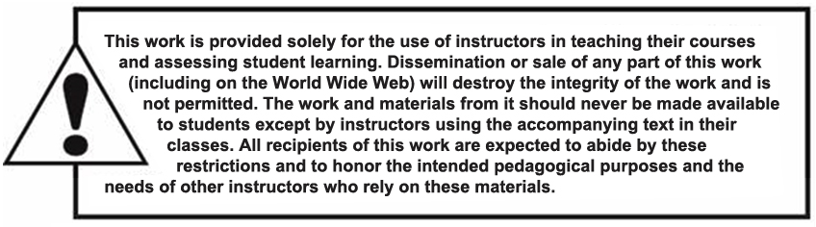
Copyright

